Slide 1

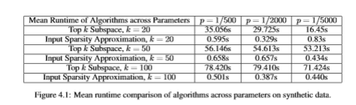
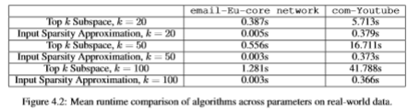





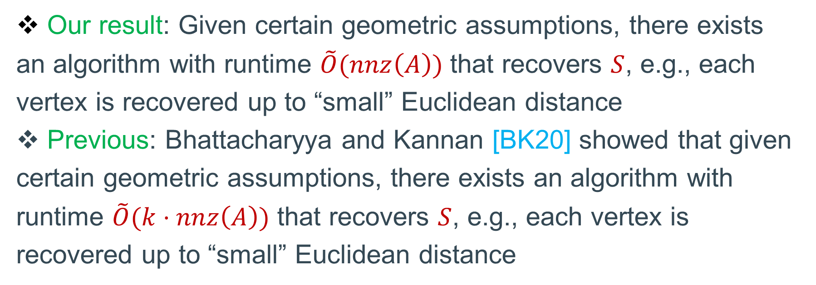


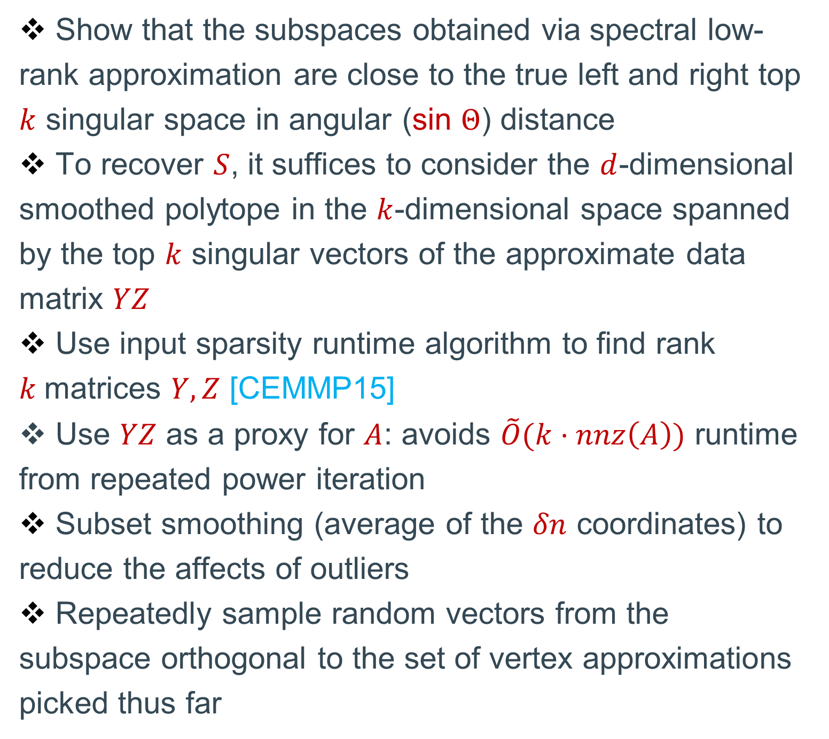




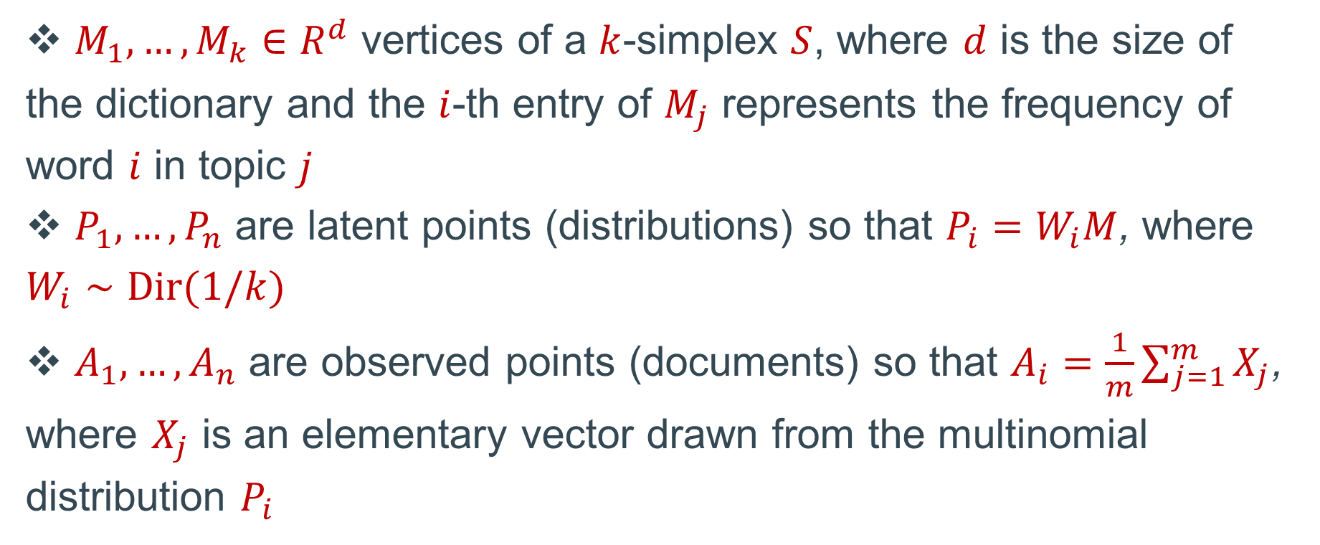



















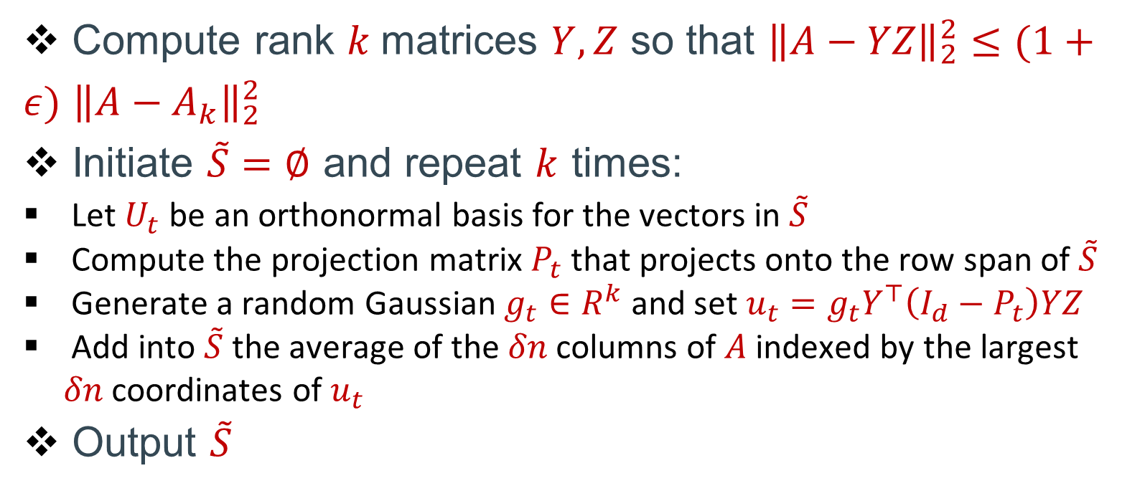










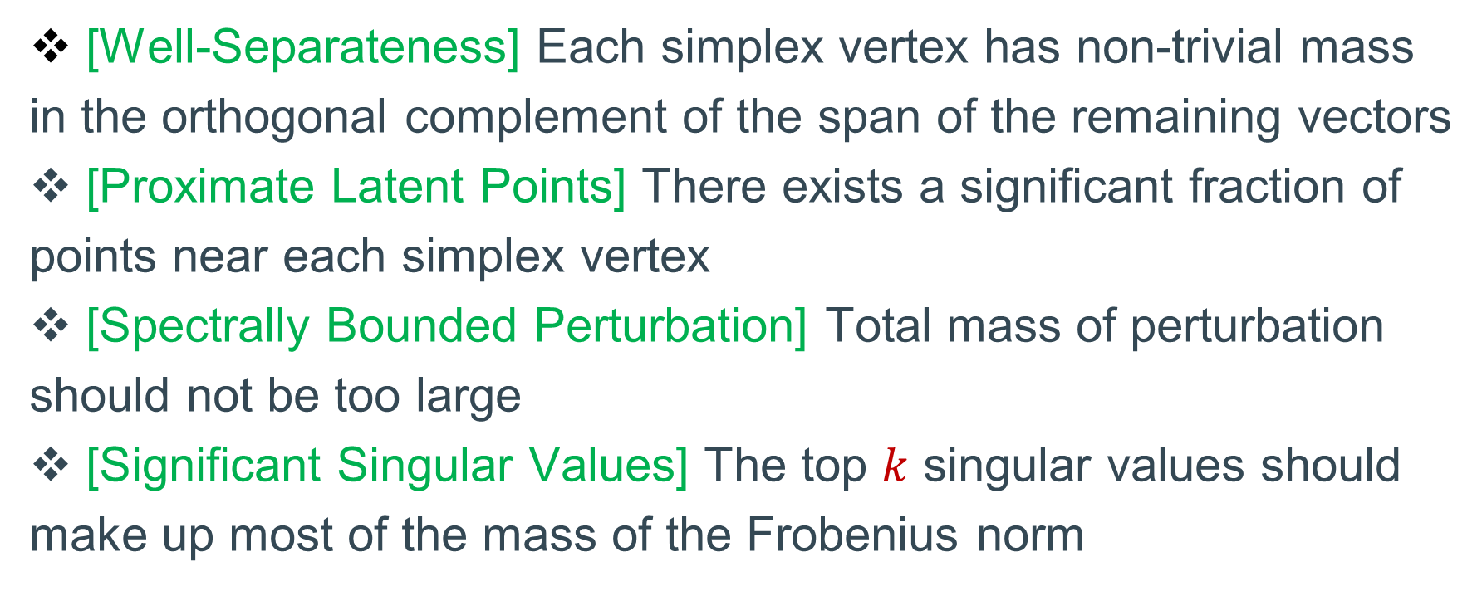



Learning a Latent Simplex in Input-Sparsity Time
Ainesh Bakshi (Carnegie Mellon University)
Chiranjib Bhattacharyya (Indian Institute of Science)
Ravi Kannan (Microsoft Research India)
David P. Woodruff (Carnegie Mellon University)
Samson Zhou (Carnegie Mellon University)
Algorithm
Problem Statement
Topic Model (Latent Dirichlet Allocation)
Compute rank $k$matrices $Y,Z$ so that ${\left\|A−YZ\right\|}_{2}^{2}≤(1+ε)$ ${\left\|A−A_{k}\right\|}_{2}^{2}$
Initiate $\tilde{S}=∅$ and repeat $k$ times:
Let $U_{t}$ be an orthonormal basis for the vectors in $\tilde{S}$
Compute the projection matrix $P_{t}$ that projects onto the row span of $\tilde{S}$
Generate a random Gaussian $g_{t}∈R^{k}$ and set $u_{t}=g_{t}Y^{⊤}\left(I_{d}−P_{t}\right)YZ$
Add into $\tilde{S}$ the average of the $δn$ columns of $A$ indexed by the largest $δn$ coordinates of $u_{t}$
Output $\tilde{S}$
$M_{1},…, M_{k}∈R^{d}$ vertices of a $k$-simplex $S$
$P_{1},…, P_{n}$ latent points in convex hull of $S$
$A_{1},…, A_{n}$ observed points perturbations of latent points $P_{1},…, P_{n}$
Goal: recover $S$ accurately and efficiently
$M_{1},…, M_{k}∈R^{d}$ vertices of a $k$-simplex $S$, where $d$ is the size of the dictionary and the $i$-th entry of $M_{j}$ represents the frequency of word $i$ in topic $j$
$P_{1},…, P_{n}$ are latent points (distributions) so that $P_{i}=W_{i}M$, where $W_{i}∼Dir(1/k)$
$A_{1},…, A_{n}$ are observed points (documents) so that $A_{i}=\frac{1}{m}\sum_{j=1}^{m}{X_{j}}$, where $X_{j}$ is an elementary vector drawn from the multinomial distribution $P_{i}$
$$M_{1}$$
$$M_{1}$$
$$P_{5}$$
$$A_{5}$$
$$M_{5}$$
$$P_{3}$$
$$P_{10}$$
$$M_{2}$$
$$M_{5}$$
$$A_{3}$$
$$A_{10}$$
$$M_{2}$$
$$P_{2}$$
$$P_{1}$$
$$P_{4}$$
$$P_{6}$$
$$A_{2}$$
$$A_{4}$$
Technical Contribution / Intuition
$$P_{8}$$
$$A_{1}$$
$$A_{6}$$
$$P_{7}$$
$$A_{9}$$
$$A_{7}$$
$$A_{8}$$
Show that the subspaces obtained via spectral low-rank approximation are close to the true left and right top $k$ singular space in angular (sin $Θ$) distance
To recover $S$, it suffices to consider the $d$-dimensional smoothed polytope in the $k$-dimensional space spanned by the top $k$ singular vectors of the approximate data matrix $YZ$
Use input sparsity runtime algorithm to find rank $k$matrices $Y,Z$ [CEMMP15]
Use $YZ$ as a proxy for $A$: avoids $\tilde{O}(k⋅nnz\left(A\right))$ runtime from repeated power iteration
Subset smoothing (average of the $δn$ coordinates) to reduce the affects of outliers
Repeatedly sample random vectors from the subspace orthogonal to the set of vertex approximations picked thus far
$$M_{4}$$
$$M_{3}$$
$$M_{4}$$
$$M_{3}$$
Results and Related Work
Applications / Motivations
Our result: Given certain geometric assumptions, there exists an algorithm with runtime $\tilde{O}(nnz\left(A\right))$ that recovers $S$, e.g., each vertex is recovered up to “small” Euclidean distance
Previous: Bhattacharyya and Kannan [BK20] showed that given certain geometric assumptions, there exists an algorithm with runtime $\tilde{O}(k⋅nnz\left(A\right))$ that recovers $S$, e.g., each vertex is recovered up to “small” Euclidean distance
Topic models: identify abstract topics in a collection of documents by discovering latent semantic structure
Mixed membership block stochastic model: recover communities in a network by observing frequencies of communication between nodes
Adversarial clustering: learn the centers of clusters whose mixture forms a set of latent points that may be perturbed adversarially but with bounded norm
Assumptions
$$M_{1}$$
$$M_{2}$$
$$M_{3}$$
$$M_{4}$$
[Well-Separateness] Each simplex vertex has non-trivial mass in the orthogonal complement of the span of the remaining vectors
[Proximate Latent Points] There exists a significant fraction of points near each simplex vertex
[Spectrally Bounded Perturbation] Total mass of perturbation should not be too large
[Significant Singular Values] The top $k$ singular values should make up most of the mass of the Frobenius norm
$$M_{1}$$
$$M_{1}$$
$$M_{2}$$
$$M_{5}$$
$$M_{2}$$
$$M_{1}$$
$$M_{2}$$
$$M_{4}$$
$$M_{3}$$
References
[BK20] Chiranjib Bhattacharyya, Ravindran Kannan: Finding a latent k-simplex in O* (k · nnz(data)) time via Subset Smoothing. SODA 2020: 122-140
[CEMMP15] Michael B. Cohen, Sam Elder, Cameron Musco, Christopher Musco, Madalina Persu: Dimensionality Reduction for k-Means Clustering and Low Rank Approximation. STOC 2015: 163-172

